Slide 1

Course: UNIVERSAL HUMAN VALUES (UHV38) Unit 3: Understanding Harmony in the Family

Slide 2
Overview
Understanding Harmony in the family – the basic unit of human interaction.
Understanding values in a human-human relationship
Understanding Vishwas, Difference between intention and competence.
Understanding Samman, Difference between respect and differentiation
Understanding the harmony in the society

Slide 3
Family
Each one of us is naturally a part of a family that includes father, mother, brother and sisters.
Then there are other relations such as grand parents, aunts, uncles, cousins etc. These relationships are a reality of our life for each one of us.
Family is the basic unit of human interaction.
It is not surprising that children who grow up in happy families are more successful and well-adjusted in life.
There is a set of proposals about the families for us to verify:

Slide 4
Set of Proposal about the Family (To be verified on natural acceptance)
Relationship exists between the self (I) and other self (I).
The self (I) has feelings in a relationship. These feelings are between I and I.
These feelings in the self (I) are definite i.e, they can be identified with definiteness.
Recognising and fulfilling these feelings leads to mutual happiness in relationship.

Slide 5
Family
Basic unit or building block of human organisation.
Provides a base for
appreciating,
accepting,
understanding
practicing to live in relationship and harmony (order)

Slide 6
Four Important Aspects Of Relationship
Relationship is – between one Self (I1) and another Self (I2)
There are feelings in relationship – in one Self (I1) for the other Self (I2)
These feelings can be recognized – they are definite
The fulfilment of these feelings and their right evaluation lead to mutual happiness

Slide 7
Relationship is – between one Self (I1) and another Self (I2)
Relationship is already there.
Need not construct or create relationship.
Need to understand relationship and fulfil it.
Relationship is between one Self and the other Self.
Self which is recognizing the relationship, and not the Body.
It is the Self which relates to the other, and not the Body.
There are feelings in relationship – in one Self (I1) for the other Self (I2)
The important issue in human relationship is that of the feelings.
Feelings are in the Self, not in the Body.
It is the Self which has the feelings and which recognises the feelings.
To understand relationship,
One has to understand the Self
Naturally acceptable feelings in the Self.

Slide 8
These Feelings can be Recognized – they are Definite
9 Feelings (values) in relationship:
1. Trust (vishwas)
2. Respect (sammana)
3. Affection (sneha)
4. Care (mamta)
5. Guidance (vatsalya)
6. Reverence (shraddha)
7. Glory (guarava)
8. Gratitude (kritagyata)
9. Love (prem)

Slide 9
Enumerate some of the important values which lie at the base of good relationships. or What are the foundational values of relationships? How can they be used to ensure strong and mutually relationships?
There are certain basic and important values in maintaining relationship. These values, we all know, are the backbone of health and happy family relations. The feelings, emotions, sentiments and respect all are of real importance. These values lead to elimination of friction and establishment of total harmony in relationship on long term basis. Values that are important in any relationship are
1. Trust: Trust or vishwas is the foundational value in relationship. To be assured that each human being inherently wants oneself and the other to be happy and prosperous. If we have trust in the other, we are able to see the other as a relative and not as an adversary.

Slide 10

Naturally Acceptable Feelings in Relationship
Affection | Affection is the feeling of being related to the other. Affection is the feeling of acceptance for the other as one’s relative. Lack of affection is seen in the form of opposition, jealousy, etc. The feelings of trust and respect are essential to have the feeling of affection.
Care | Care is the feeling of responsibility and commitment for nurturing and protection of the Body of my relative. With the feeling of affection, one naturally takes the responsibility for development of the relative – both at the level of Self as well as at the level of Body. Being responsible to the Body of one’s relative is Care.
Guidance | Guidance is the feeling of responsibility and commitment for development of Self by ensuring the right understanding and right feeling in the Self of my relative. Being responsible to the Self of my relative is Guidance. Generally, our focus is mostly on care because we have come to assume that human being is Body. We are not even aware of the Self. Therefore, we are not aware that we have to take care of the Self as well.

Slide 11
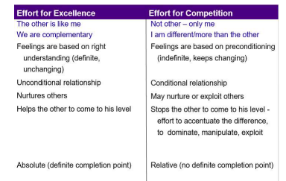
Naturally Acceptable Feelings in Relationship (Contd..)
Reverence | Reverence is the feeling of acceptance for excellence. Excellence is to be in a state of continuous happiness with the completeness of understanding of harmony and living in harmony at all levels. Once we achieve excellence, it continues. Excellence is something definite, something absolute. If you have achieved excellence, you would naturally make effort for helping others to achieve excellence. On the other hand, in competition, we not only do not help rather we hinder the other to reach to our level.

Slide 12
Naturally Acceptable Feelings in Relationship (Contd..)
Glory | Glory is the feeling of acceptance for those who have made effort for excellence. For all those people whom we call great people, when we accept the effort made for excellence by them, to whatever extent they are able to achieve it, we naturally have a feeling of glory for them.
Gratitude | Gratitude is the feeling of acceptance for those who have made the effort for my excellence. In our life, there may be so many people who have been of help to us in the process of understanding harmony and living in harmony. So, we have this feeling of gratitude for them. Gratitude is a significant feeling in the development of relationship.
Love | Love is the feeling of being related to everyone, to all. It starts from affection, which we have already explored. If this feeling expands to many and ultimately to all, it is the feeling of love. So, we begin with the feeling of affection, and complete it with the feeling of love. That is why, Love is called complete value.

Slide 13
Under Evaluation, Over Evaluation and Otherwise Evaluation
Under Evaluation: When someone is evaluated less than what it is. Under evaluation someone means disrespecting them as it shows that their abilities have been neglected. This can give rise to sense of dissatisfaction.
Over Evaluation: To evaluate someone more than what he is.
Otherwise Evaluation: When we evaluate someone for what they are not. It can mean over evaluating someone or in certain cases under evaluation.

Slide 14
Explain the feeling of care and guidance. What role do these feelings have in parent child relationship?
Following are the role of care and guidance feelings in parent and child relationship:
In the caring role, parent takes care of children’s basic needs, such as food, medical care, shelter, clothing, etc., as well as give love, attention, understanding, acceptance, time and support
The other job of parent is to provide “guidance” for the children. In this role, parent give direction, impose rules, use discipline, set limits, establish and follow with consequences, hold children accountable for their behaviour and teach values.

Slide 15
Justice in Human Relationship
Justice is the recognition, fulfillment and evaluation of human-human relationship, leading to mutual happiness.
Recognition of relationship means recognizing the naturally acceptable feelings in relationship rightly.
Fulfilment of relationship means Ensuring the naturally acceptable feelings in oneself.
Living with responsibility with the other with these feelings, forming the basis of relationship. This makes the other comfortable and assured.
Making effort for mutual development, i.e. development of one’s own competence and being of help to the other in developing their competence.
Evaluation means verifying that I have the right feeling, I am able to express it properly, the right feeling has reached to the other and the other is able to identify it as the right feeling.
When the recognition, fulfilment and evaluation are right from my side, I feel happy.
When the other is able to evaluate the expression of my feeling rightly, then (s)he also feels happy. Developing this competence may take time.
Justice is desirable in the family and beyond the family, all the way to the world family.

Slide 16
Justice in Human Relationship
Justice starts from family and slowly expands to the world family. The child gets
the understanding of justice in the family. With this understanding, he goes out in the society and interacts with people.
If the understanding of justice is ensured in the family, there will be justice in all the interactions we have in the world at large. If we do not understand the values in relationships, we are governed by our petty prejudices and conditionings.
We may treat people as high or low based on their body (particular caste, or sex or race or tribe), on the basis of wealth one possesses or the belief systems that one follows.
All this is source of injustice and leads to fragmented society while our natural acceptance is for an undivided society and universal human order.
Having explored the harmony in the human beings, we are able to explore the harmony in the family.
This enables us to understand the harmony at the level of society and nature/ existence. And this is the way, the harmony in our living grows. We slowly get the competence to live in harmony with all human beings.

Slide 17
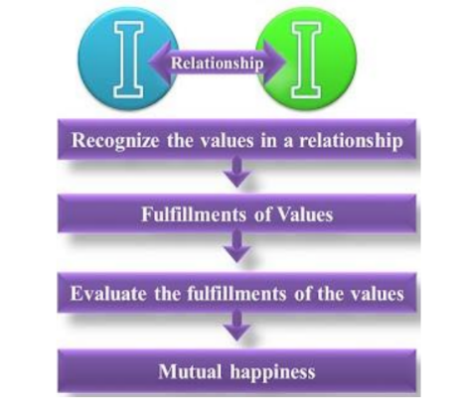
Justice in Human Relationship

Slide 18
Fulfilment of feelings in relationship and their evaluation leads to mutual happiness
These are the feelings
which we can understand,
which we can ensure within ourselves,
which we can share with others and thus ensure mutual fulfilment in relationship.
These are the feelings which are naturally acceptable to us in the relationship with the other human being

Slide 19
Appraisal of the Current Status
Assume ourselves to be the Body
Assume the relationship on the basis of the Body (and not the feelings).
Hence we fail to understand relationship and consequently, we fail to fulfil it, despite all our good intentions.
Problem is due to absence of one or more of the right feelings in the Self.
And we try to make up this gap by physical facility or by trying to demand these feelings from others, rather than ensuring these feelings in ourselves and sharing it with others

Slide 20
The Way Ahead
Righty recognize the relationship,
Identify the naturally acceptable feelings in relationship,
Understand these feelings and ensure that these feelings are there in us.
Result
Ensure happiness in us.
Share these feelings with the other.
Leads to happiness in the other also.
Thus, it will lead to mutual happiness. And that is how the fulfilment in relationship takes place.

Slide 21
Trust, Difference between intention and competence
Trust or Vishwas is the foundational value in all relationship.
“To be assured that each human being inherently wants oneself and the other to be happy and prosperous” is known as trust.
Mutual trust is a shared belief that we can depend on each other to achieve a common purpose. Trust is the expectation of people that they can rely on our word. It is built through integrity and consistency in relationships. There are two aspects in trust:
1. Intention (wanting to – our natural acceptance)
2. Competence (being able to do)

Slide 22
Trust, Difference between intention and competence
Both intention and competence are the aspects of trust. Intention is what one aspires for (our natural acceptance) and competence is the ability to fulfill the aspiration. In intention every human being wants to do what is right, only the competence may be lacking which needs to be developed through proper understanding and practice.
But what we are doing today is that when we are judging our self we are judging on the basis of our intention, whereas, when we are judging the other we are judging him on the basis of his competence.
We trust our own intention while we are not ready to trust the others intention. It is the same for other as well. We find that while we look at our intention, we are sure of it, we are not sure of the other’s intention. We are actually seeing their competence, and making a conclusion on their intention. Hence, mistrust is born and we deny the relationship. We seldom look at our competence and other’s intention.
It is very important to differentiate between intention and competence. If we have trust on intention, we have a feeling of being related to the other and we start helping the other to improve his competence, if he does not have enough

Slide 23
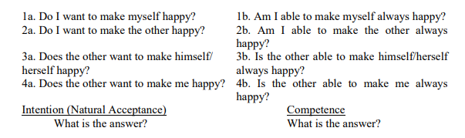
'Trust' – the Foundational Value in Relationship
Feeling of Trust
Trust is to be assured that the other intends to make me happy and prosperous

Slide 24
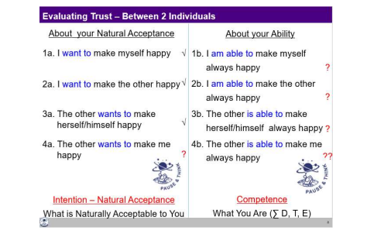

Slide 25
Distinguishing between Intention and Competence
If you try to analyse your own responses, many things will get clarified.
While evaluating yourself, you evaluate on the basis of your intention (natural acceptance).
When you evaluate the other, you evaluate him on the basis of his/her competence.
On the basis of lack of competence, we conclude about the lack of intention of the other
When we doubt their intention, instead of accepting the other as a relative, we have a feeling of opposition.

Slide 26
If you have unconditional, continuous trust on intention, on the natural acceptance of the other and if the other is lacking competence, what will you do?
a) Try to improve upon his competence
b) Get irritated
c) Get angry
d) Have a feeling of opposition
The answer is obviously (a). It is a response which indicates trust on intention.
All other answers are reactions based on doubt on intention.
Now with these indicators, find out how many people are there in your life on whom you have trust on intention (natural acceptance) which is unconditional and continuous.

Slide 27
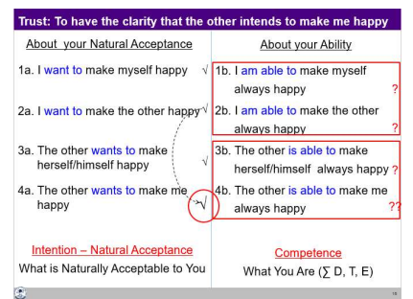
Generally, we don’t see intention and competence separately.
Since competence is generally lacking,
The feeling of unconditional acceptance is almost completely missing;
There is a feeling of opposition.
We reinforce wrong assumptions like:
Strangers can’t be trusted (?)
Trust is developed over a long-time (?)
Never trust anyone (?)
With the feeling of trust, one is able to see it clearly that the intention is same for all, to be
happy and make other happy. The only difference lies in the level of competence.

Slide 28
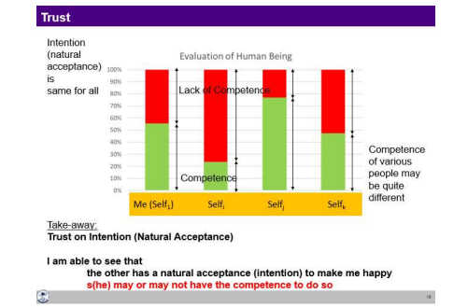

Slide 29
Key Takeaways
Trust is to be assured that the other has a natural acceptance (intention) to make me happy and prosperous.
Trust on intention is the foundation of relationship. It is the beginning of mutual development.
Common mistake –
Evaluate oneself on the basis of one’s intention (and conclude that I am good)
Other on the basis of their lack of competence (thus doubt their intention and conclude that the other is bad).

Slide 30
Respect– As the Right Evaluation
Feeling of Respect (samman)
Respect is right evaluation.
When we are rightly evaluated, we feel respected.
When we are not rightly evaluated, we feel disrespected.
Disrespect can take place in three ways:
Over evaluation – evaluating for more than what it is
Under evaluation – evaluating for less than what it is
Otherwise evaluation – evaluating for other than what it is
If any of these three takes place, the other person feels uncomfortable, disrespected.

Slide 31
Minimum Content of Respect – The Other is Similar to Me
When we evaluate the human being on the basis of Self, we are able to see that:
Our purpose is the same –
As I have a natural acceptance to live with continuous happiness and prosperity, it is same with the other.
So, on the basis of our natural acceptance, we have the same purpose.
Our programme is same –
As my programme to achieve continuous happiness and prosperity is to understand the harmony and live in harmony at all levels of my being (from human being to the entire existence), it is same with the other.
In that sense, our programme to fulfil our purpose is also same.
Our potential is same –
As I am endowed with natural acceptance and the activities of desire, thought and expectation are going on continuously in me, it is the same with the other.
So, our potential is also same.
Thus, we can see that the other (Self) is similar to me. This is the minimum content of respect for a human being.

Slide 32
Defining one’s complementarity:
If the other has more understanding, is more responsible than me, I’m committed to understand from the other
If I have more understanding than the other, I’m more responsible than the other.
I live with responsibility with the other, unconditionally, unperturbed by the behaviour of the other.
I am committed to facilitate the understanding in the other, once the other is assured in relationship and not before that.
The complete content of respect is
The other is similar to me in terms of purpose, programme and potential
We are complementary to each other in terms of competence

Slide 33
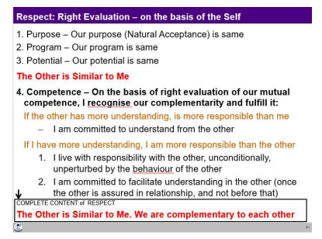

Slide 34
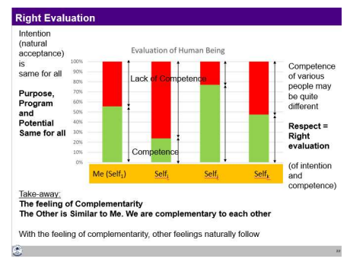
Thus, respect is right evaluation (of intention and competence on the basis of Self).
We are similar at the level of purpose, programme and potential and we are complementary at the level of competence.
Disrespect arises out of over-evaluation, under-evaluation or otherwise-evaluation; and also, out of differentiation leading to discrimination on the basis of body, physical facility or beliefs.
Small incidents of disrespect can have long-lasting consequences – from not speaking to each other, to opposition, break in relationship, divorce, fights and even war.

Slide 35
With the complete understanding of respect,
see for every individual on the earth that we all are the same in terms of intention, program and potential.
The only difference may lie in the level of competence.
I may be having higher level of competence in relation to one, but may be having lower level of competence in relation to another.
With this evaluation, one can work out the program to be complimentary to the other.
All the specific characteristics at the level of Body, physical facility, belief etc. can be used to express that complementarity.
a person with greater physical strength do the heavy work
a person at a higher post can work for the development of more people and so on

Slide 36
Disrespect Arising out of Differentiation leading to Discrimination
First set of differentiation is on the basis of body–
On the basis of age, gender, race and physical strength.
Based on the gross misunderstanding that human being = Body.
The truth is that human being = co-existence of the Self and the Body.
The second set of differentiation is made on the basis of physical facility –
On the basis of wealth and post.
The gross misunderstanding here is that physical facility = happiness.
The truth is that happiness is to be in a state of harmony.
The third basis of differentiation is on the basis of beliefs –
On the basis of different isms (thought systems like socialism, capitalism, etc.), different sects, and different sets of information prevalent in the society.
Founded on the misunderstanding that if the pre-conditioning of the other matches with mine, then the other is respectable, otherwise not.
The truth is that pre-conditioning and right understanding are two different things.

Slide 37
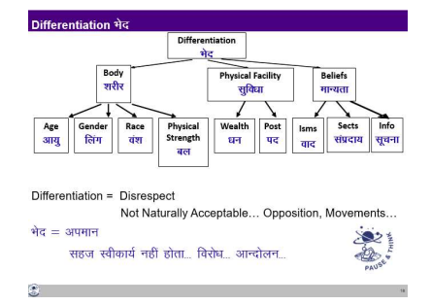
All this differentiation ultimately leads to discrimination, which is disrespect because it is not naturally acceptable.

Slide 38
Differentiation
On the basis of body
➢ Sex/gender: We ignore the fact that being male or female is an attribute of the body, and not an attribute at the level of ‘I’. And differentiate in giving respect on the basis of gender called male and females. In many countries, people even prefer a male child to a female child, and in some other societies, the other way round.
➢ Race: If the person is of the same race as oneself, then we treat them differently. For example, we differentiate on the basis of skin colour – white, brown, black etc. or on the basis of whether the person is of Aryan race, Mongolian race etc. or on the basis of caste. Again here, we don’t do the evaluation on the basis of ‘I’, but on the basis of the body
➢ Age: We have notions such as ‘one must respect elders’. There is no such notion as respect youngsters. Here, we see that we are again evaluating at the level of the body – age is related to the body, and not to ‘I’.
➢ Physical strength: If someone is stronger, we again treat him/her differently. This is again at the level of the body. In fact, we think that we are respecting the other while it is fear; the fear that if we do not treat them like this, we will be harmed.

Slide 39
Differentiation
On the basis of physical facilities
➢ Wealth: We differentiate people because some have wealth than others. What we term as a “rich person gets idolized”. We don’t even bother to find out whether such people are feeling prosperous, or if they just have wealth. This way, we are over-evaluating physical facilities first, which are just meant to fulfill the needs of the body, and then on this basis, we are wrongly identifying our relationship.
➢ Post: We try to respect on the basis of a person’s position. The post is wrongly evaluated as the mark of a person’s excellence and differentiation sets in. The post is considered important either on the basis that it gives more physical facilities or on the basis that certain positions are assumed to be important.
In our education, we are trained directly or indirectly to earn posts for us to fetch respect

Slide 40
Differentiation
On the basis of beliefs
➢ ‘Isms’: ‘Ism’ means any belief in terms of a ‘thought-system’ that we have, or that we have adopted. There are also many modern ‘isms’ such as capitalism, socialism, communism, etc. The people following these sets of beliefs are called capitalists, socialists, communists, and so on. The people that have adopted them or are following them have been exposed to them since childhood. Believing theirs to be the right belief. However, all beliefs, as we have seen are at the level of desires, thoughts and expectations (selections) in ‘I’. There is no definiteness at this level, and hence, this becomes a cause for differentiation.
➢ Sects: People of one sect only consider those with a similar belief system to be their ‘own’ and worthy of respect. Following a particular tradition, or what we call as religion, becomes the basis of respect and disrespect in relationship.

Slide 41
Problems faced due to Differentiation in relationship
Differentiation based on sex/gender: Issue of women’s rights, and women protesting and demanding for equality in education, in jobs, and in people’s representation. People are insecure and afraid of one another based on their gender.
Differentiation based on race: there are many movements and protect against racial discrimination and demands for equality, racial attacks, movements against cast discrimination has people living in fear of such racism, racist attacks, castism and discrimination.
Differentiation based on age: Protests and movements demanding for equal rights for children on the one hand and for rights for elderly people on the other, generation gap
Differentiation based on wealth: Class struggle and movements to do away with class-differentiation. Many people suffering from a lack of self-esteem and some even committing suicide,
Differentiation based on post: Protests against high handed government officials. At the level of the individual, leads to depression, etc.
Differentiation based on ‘isms: Fights, turmoil, terrorism and war, people converting from one Ism to another in order to be able to get more respect.
Differentiation based on sects: Countless religions and sects and each sect has its own movement to ensure that there is no discrimination against people of their belief. Demands for special provisions in jobs and in education

Slide 42
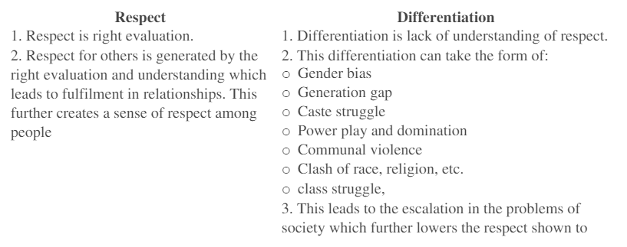
Difference between Respect & Differentiation

Slide 43
Role of Physical Facility in Fulfilment of Relationship
Physical facility has a limited role to play in the fulfilment of the feeling in human relationship.
To fulfil the feeling of care, physical facility is certainly required.
For other than the feeling of care, physical facility only has a symbolic role to play.
Response and Reaction in Behaviour
An important implication of understanding relationship, particularly trust on intention, is the clarity about problems in living in reaction and the possibility of living with response.
With response, your conduct is definite while with reaction, the conduct is indefinite.

Slide 44
My Participation (Value) in Family
My participation (value) with my family is to ensure harmony in the family, ensure mutual happiness, ensure justice in the family by way of:
Ensuring right feelings (trust, respect, affection, care, guidance, reverence, glory, gratitude and love) in myself – this leads to my happiness.
Expressing (sharing) these feelings with the other. When the other is able to make the right evaluation of these feelings, it leads to his/her happiness, thus leading to mutual happiness. My participation is to be of help to the other in their self-evolution, self-development.
With this preparation in the family, I have the ability to participate meaningfully in the larger society – in the neighbourhood, in the community and so on.

Slide 45
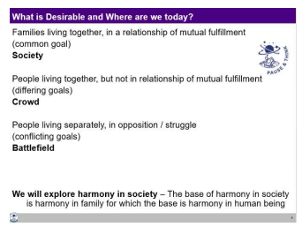
Understanding Harmony in the Society
The next level of living for a human being is society.
We can conceive of a society only if it has families living together in a relationship of mutual fulfillment otherwise it is just like a crowd or battlefield.

Slide 46
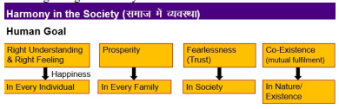
Understanding Human Goal
We can explore and see what is naturally acceptable?
Right understanding in every human being or only a few to have right understanding and others to follow them?
Prosperity in every family or few families to have accumulation, and others to be deprived and dependent on the few?
Fearlessness, based on trust and affection, in the society or a state of fear, based on mistrust and jealousy in the society?
Co-existence (mutual fulfilment) in nature or exploitation and domination of nature?

Slide 47
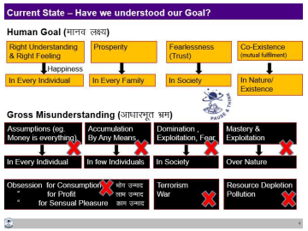
Appraisal of the Current Status
Due to the prevailing false assumptions of happiness (like money is everything),
Happiness is sought through accumulation of physical facility (money) by any means, and using it for getting sensations from the body or feelings from others.
The second goal of prosperity is similarly seen as accumulating more and more.
With these as the driving assumptions in the society, it has led to people living with three kinds of obsessions:
1. Obsession for consumption
2. Obsession for profit
3. Obsession for sensual pleasure
Instead of the third goal of fearlessness (trust), we have domination, exploitation and fear in the society.
Finally, instead of mutual fulfilment, we are mostly trying to exploit and be the master over nature.

Slide 48
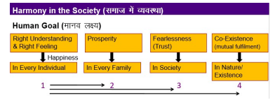
The Way Ahead : There is a need for understanding the harmony in society and living accordingly. The correct sequence in which these four goals can be fulfilled

Slide 49
Programs needed to achieve comprehensive Human Goal
Education-Sanskar
Health-Self regulation
Production-Work
Justice-Preservation
Exchange-Storage
Education-Sanskar->(leads to) ->Right understanding and right feeling (happiness)
Health-self-regulation -> (leads to)-> Prosperity
Production-Work ->(leads to) -> Prosperity
Justice-Preservation -> (leads to) -> Fearlessness and Co-existence (respectively)
Exchange–storage -> (leads to) -> Prosperity and Fearlessness

Slide 50
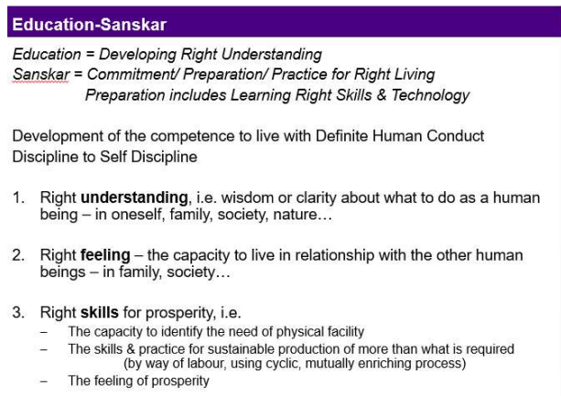
Education-Sanskar
Education is to develop right understanding of the harmony at all levels of being – from self to the entire existence (individual, family, society, and nature/existence).
Sanskar is to develop the basic acceptances of the harmony at various levels.
Education provides the commitment, preparation and practice of living in harmony at all levels.
Preparation includes learning the skills and technology for living in harmony.
Our living is an expression of our sanskar.

Slide 51
Health and Self-regulation
Self-regulation is the feeling of responsibility towards the Body, for nurturing, protection and right utilization of the Body.
Health of the Body is indicated by the fact that it is able to act according to the instruction of the Self and the different parts of the Body are in harmony

Slide 52
Production-Work
Work is the effort a human being does on the rest of nature and Production is the physical facility obtained from work.
There are two important issues related to production-work:
What to produce?
How to produce?
Regarding what to produce – we have to produce physical facility required for nurturing, protection and right utilisation of the Body.
Regarding how to produce
1. The process needs to be cyclic and mutually enriching – it has to be eco-friendly
2. Justice needs to be ensured in relationship with human being – it has to be people-friendly
A production process is cyclic when the resources utilised in the process return to their original state in due course of their lifecycle.
In the absence of being in tune with the natural processes, what we see ultimately is resource depletion and pollution. Resource depletion is the symptom of using a natural resource at a rate which is greater than the rate at which it is produced in nature.
For example, if we use forest at a rate greater than the rate at which it is produced in nature, there will be a shortage/ depletion of forest. Similarly, pollution indicates that we are producing something which does not return to the cycle in nature Plastic, for example, does not degrade, it does not return to the cycle of nature for many years.

Slide 53
Justice-Preservation
Justice is recognition of human-human relationship, its fulfilment and evaluation leading to mutual happiness. Feeling is the core issue.
In order to ensure justice in the society, we need to develop the competence to understand and ensure justice in every individual.
In case someone is not able to develop this competence and ends up doing injustice then:
Stop the him from doing further injustice, as well as
Help him/her to develop the competence for ensuring justice.
In the present system, mostly we seem to be restricting ourselves at (a) and not doing (b).
Preservation has to do with relationship of human being with the rest of nature.
Preservation is the recognition of relationship of human being with the rest of nature, its fulfilment and evaluation leading to mutual fulfilment.
Precisely, preservation would mean enrichment, protection and right utilization of the rest of the nature.
Preservation ensures
Prosperity in human being
Enrichment, protection and right utilisation of the rest of the nature Justice ensures fearlessness (trust) in the society and preservation ensures the mutual fulfilment (coexistence) with rest of the nature.

Slide 54
Exchange-Storage
Exchange means sharing or exchanging physical facility with a view of mutual fulfillment and not with the obsession for profit.
The sharing is within the family, or to the extent one has been able to accept relationship. Beyond that is exchange.
Through sharing and exchange of physical facility, each family can have all that it needs, i.e. there is mutual fulfilment.
Storage is preserving physical facility after the fulfillment of needs, so that it is available, when required.
This is done with a view of mutual fulfilment and not with the obsession for accumulation or exploitation.

Slide 55
The scope of the society is from family order to world family order.
Every human being has a role in one or more of the social systems, starting from the family order, then the family cluster order and so on to the nation family order and ultimately, the world family order, leading to universal human order.
Family order refers to the system in a family of responsible people living together for the common human goal.
The family cluster order is the next larger unit- It is the system that a group of families evolve in order to fulfil those goals of individual families which require the participation of more people than the family has.
The scope of the system from the family order to the world family order is indicated below. It is ensured through successively larger and larger complementary units,

Slide 56
Natural Outcome of Right Understanding & Prosperity
1. The happiness is ensured by having the right understanding and right feeling in the Self.
2. The prosperity is a feeling of the availability of more than required physical facility. To ensure it, Right understanding is required at the base, along with physical facility.
3. The tradition of living with happiness and prosperity starts from the family order and ultimately, continuity can be ensured by the universal human order.
In this way, the society with happiness in every individual, prosperity in every family, fearlessness (trust) in the society and co-existence (mutual fulfillment) in nature/existence is realized. This is one’s participation (value) in relation to society.

Slide 57
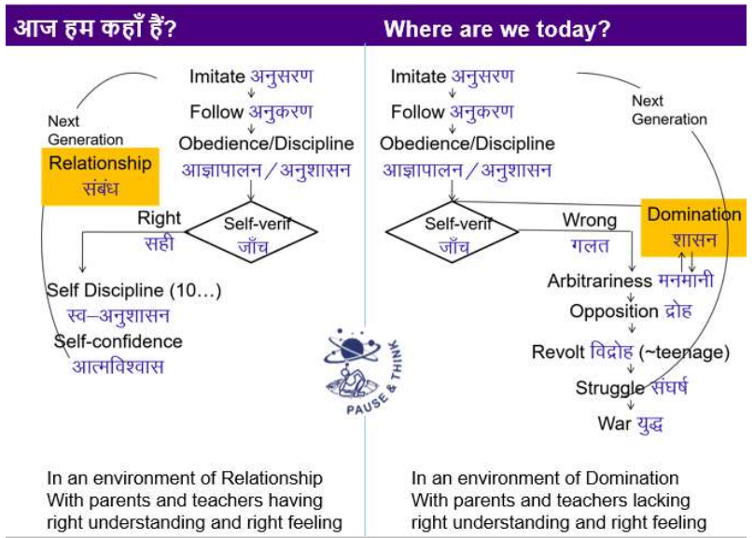

Slide 58
Key Takeaways
At the level of society, the human goal is right understanding and right feeling (happiness) in every individual, prosperity in every family, fearlessness (trust) in society and co-existence (mutual fulfilment) in nature/existence.
This goal is fulfilled by human order, i.e. systems for education-sanskar, health-self regulation, production-work, justice-preservation and exchange-storage.
These systems start with the family order, and are interconnected right up to world family order, leading to universal human order.
The natural process of development of a child in an environment of relationship needs to be understood and fulfilled so that the child grows into a human being who can have the competence to participate in the universal human order.

Slide 59
THANK YOU

